Slide 1
Colorectal Cancer
By Davin Dayle

Slide 2
Introduction
Since I work in the area of Population Health I thought it would be interesting to analyze the incidences of colorectal cancer rates by age in the US.
It has been documented that there is a rise in the instances of colorectal cancer among younger people.
The data compares colorectal cancer rates between 2008 to 2013.
Dataset was taken from the sample dataset https://data.world/cdc/us-chronic-disease-indicators listed in the Capstone Project Documents.

Slide 3
What is Colorectal Cancer?
Cancer starts when cells in the body start to grow out of control
Colorectal cancer starts in the colon or the rectum
These cancers can also be called colon cancer or rectal cancer depending on where they start
Colon Cancer and rectal Cancer are often grouped together because they have many features in common

Slide 4
How does colorectal cancer start?
Most colorectal cancers start as a growth on the inner lining of the colon or rectum. These growth are called polyps.
Some types of polyps can change into cancer over time (usually many years), but not all polyps become cancer. The chance of a polyp turning into cancer depends on the type of polyp it is.

Slide 5
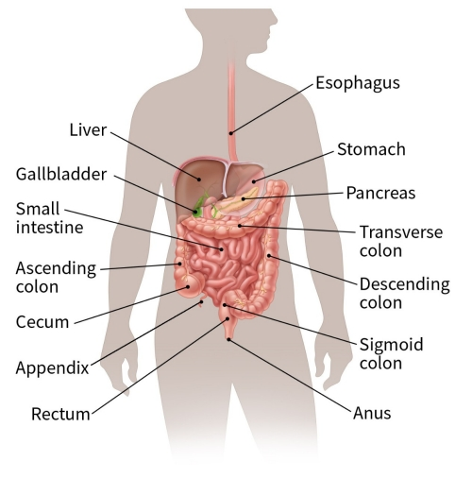
How does colorectal cancer spread?
If cancer forms in a polyp, it can grow into the wall of the colon or rectum over time
The wall of the colon and rectum is made up of many layers. Colorectal cancer starts in the innermost layer (the mucosa) and can grow outward through some or all of the other layers
When cancer cells are in the wall, they can then grow into blood vessels or lymph vessels (tiny channels that carry away waste and fluid). From there, they can travel to nearby lymph nodes or to distant parts of the body
The stage (extent of spread) of a colorectal cancer depends on how deeply it grows into the wall and if it has spread outside the colon or rectum

Slide 6
Colorectal Cancer Risk Factors You Can Change
Overweight or obese
Lack of physical activity
Diet high in red meat(beef, pork, lamb, or liver)
Diet high in processed meats(hot dogs, luncheon meats)
Cooking meats at very high temperatures
Low blood levels of Vitamin D
Smoking
Moderate to heavy Alcohol Use

Slide 7
Colorectal Cancer Risk Factors You Cannot Change
Age-your risk goes up as you age. Colorectal cancer is rising among people younger than age 50
History of Polyps
Inflammatory Bowel Disease(IBD)
Family history of colorectal Cancer in a first degree relative(parent, sibling, or child)
Racial and ethnic background
African Americans have the highest colorectal cancer rates
Jews of Eastern European descent have one of the highest colorectal cancer rates
Having Type 2 Diabetes

Slide 8
Preventive Measures
Colorectal Cancer Screening starting at age 45
Colonoscopy
FIT Testing
Body Weight, Physical Activity, Diet
Limiting Alcohol consumption
Not Smoking
Taking Aspirin or other non-steroidal anti-inflammatory drugs(NSAIDs)

Slide 9
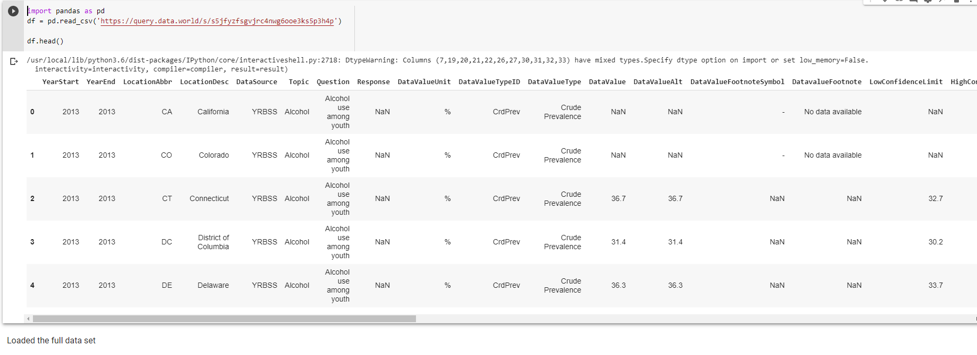
Loaded the Full Data Set From Chronic Disease Database

Slide 10
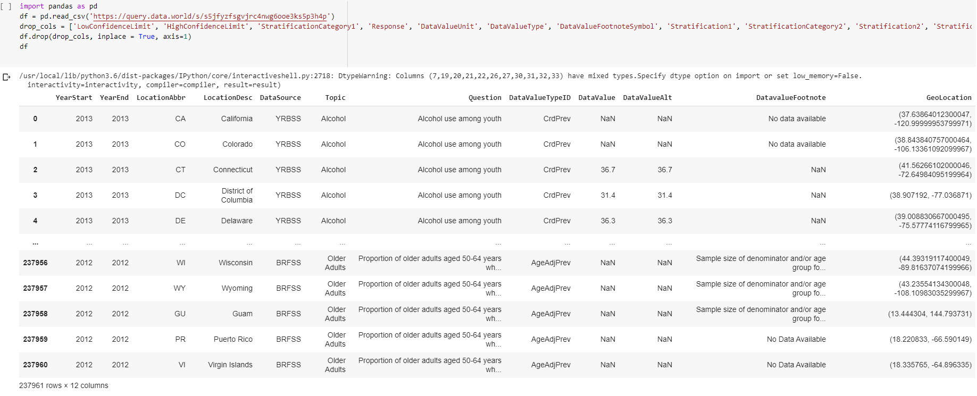
Data Cleaning by dropping unnecessary columns

Slide 11
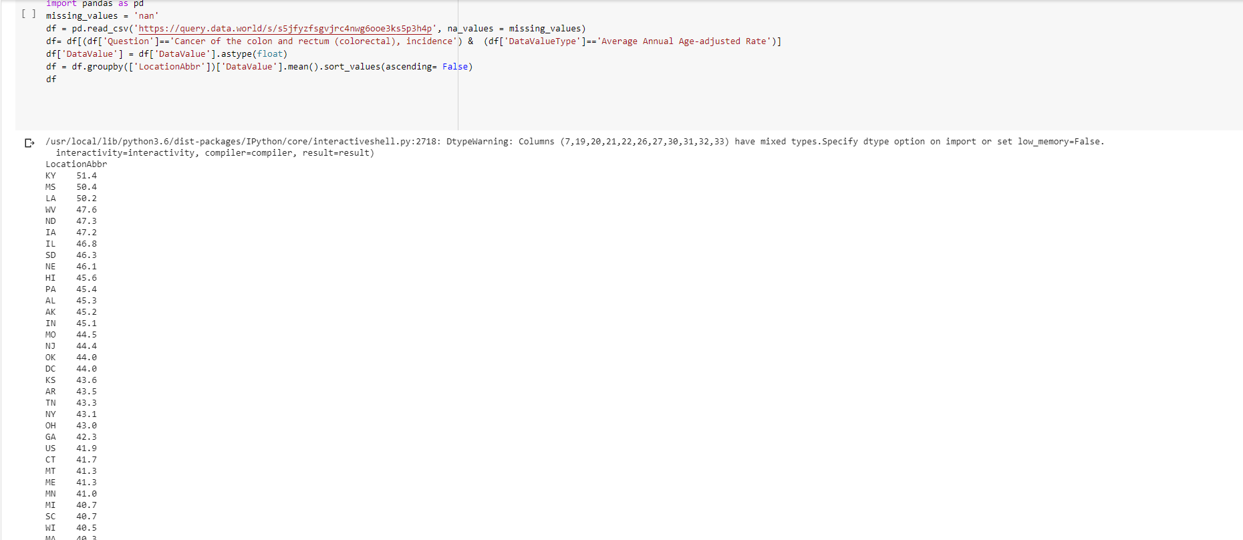
Calculated Average Annual Age of Colorectal Cancer Cases by State(2008-2012)

Slide 12
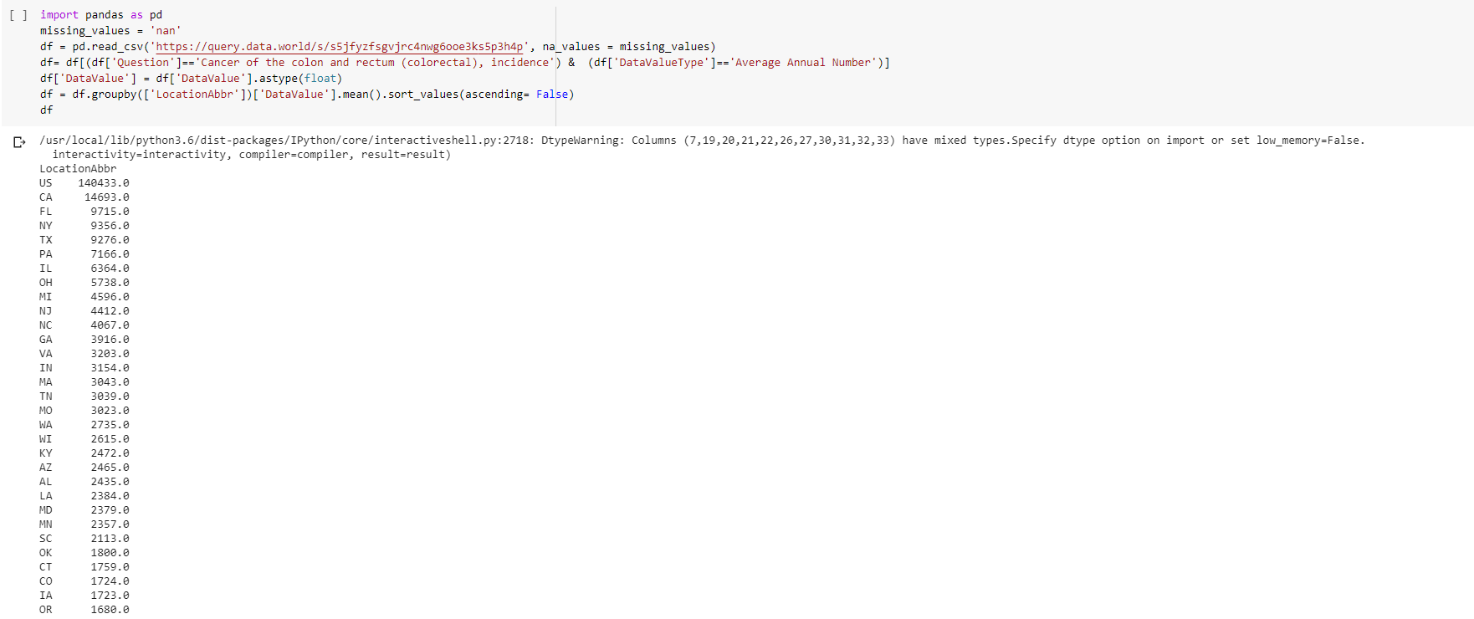
Calculated Average Annual Number of Colorectal Cancer Cases by State(2008-20012)

Slide 13
